Slide 1
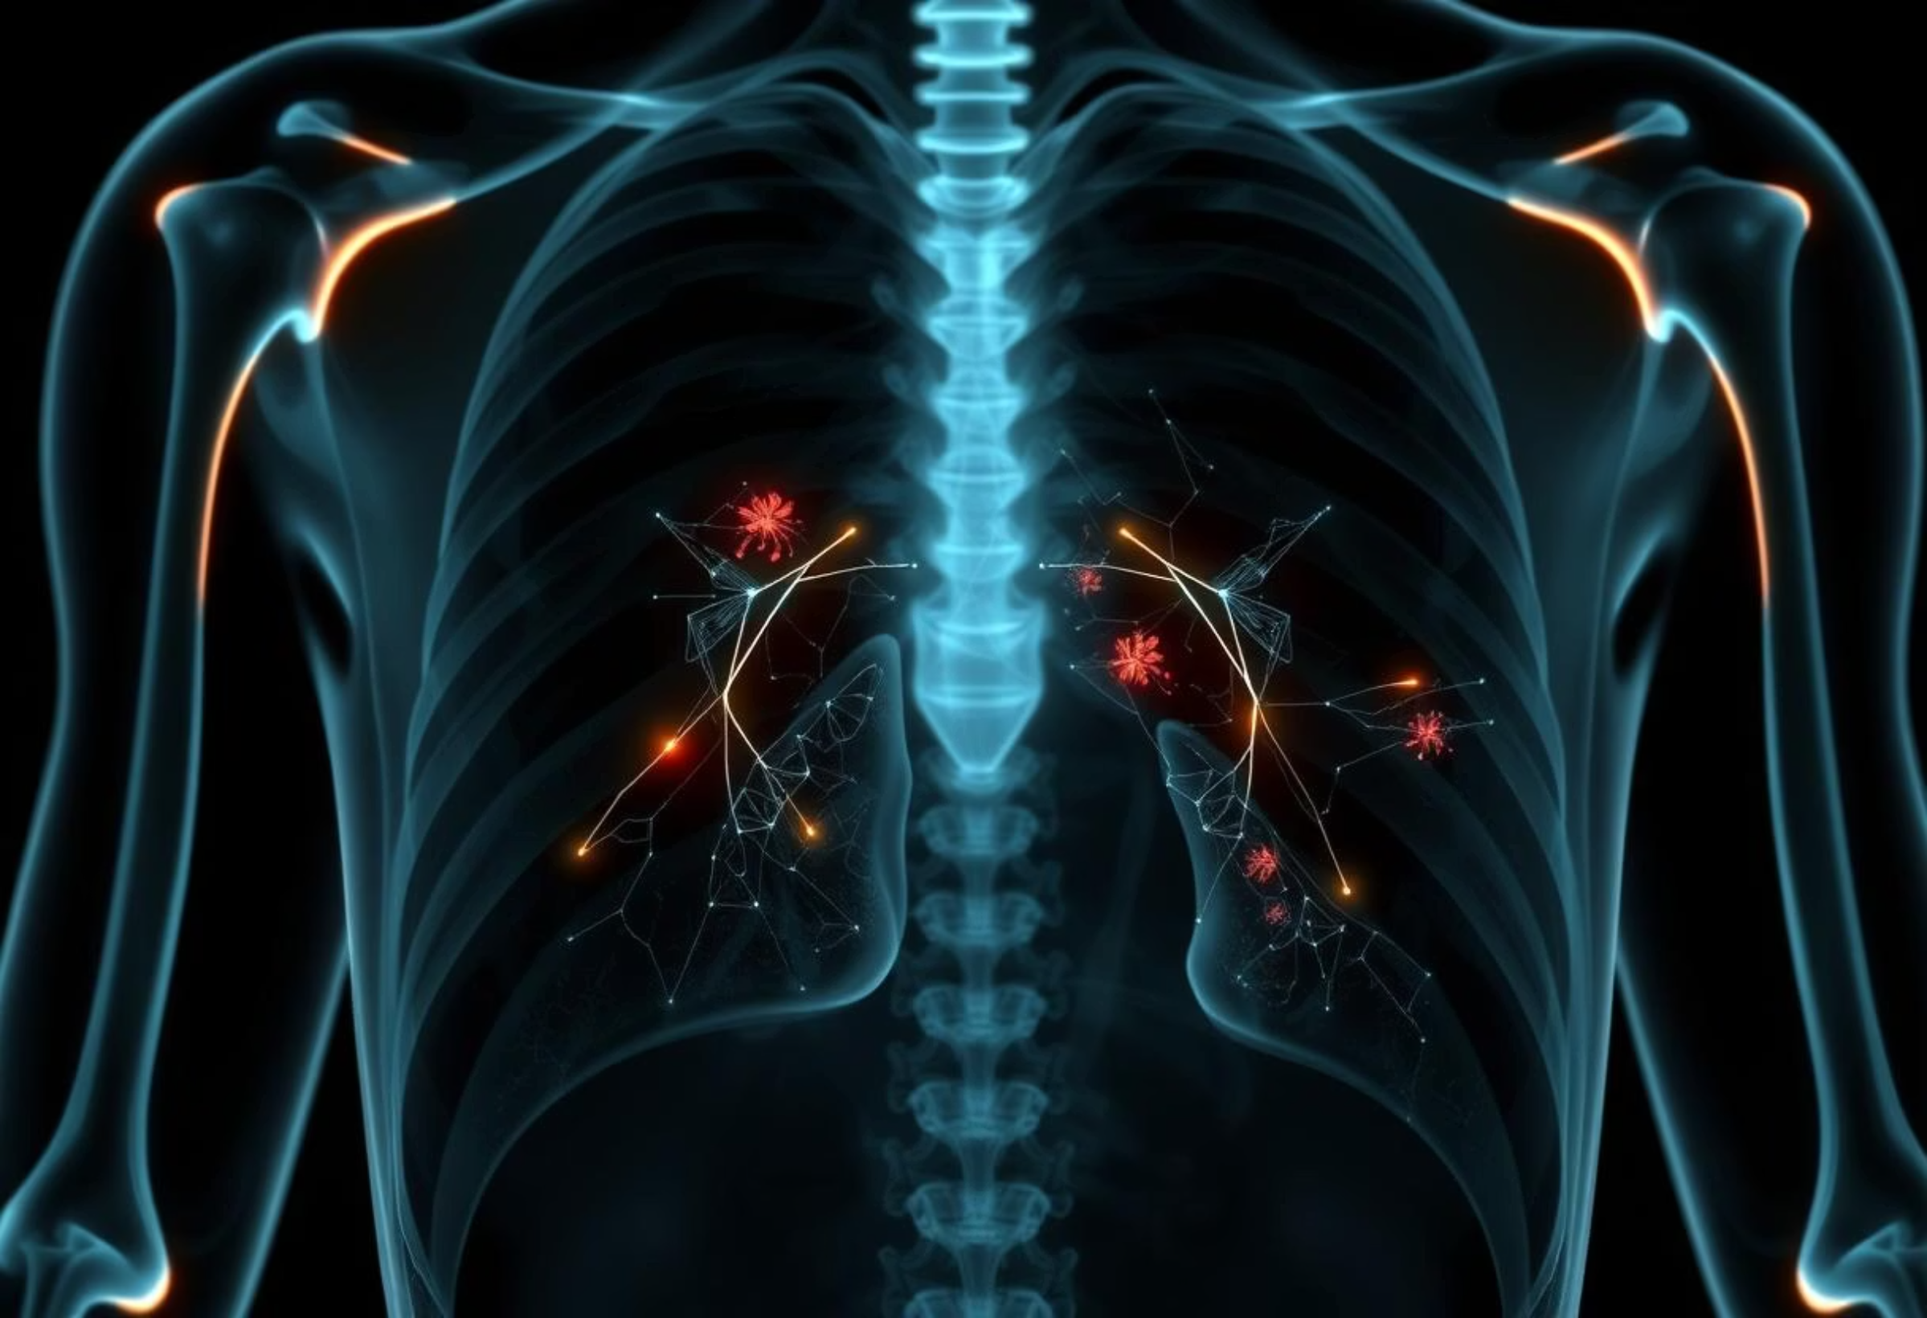
Deep Learning for Chest X-Ray Classification: Automating Respiratory Disease Detection
Leveraging AI to enhance diagnostic efficiency and accuracy in medical imaging.

Slide 2
Introduction
Revolutionising Respiratory Disease Diagnosis
Traditionally, the detection of respiratory diseases via Chest Radiography (CXR) has been a cornerstone of medical diagnostics. However, this process relies heavily on the subjective expertise of radiologists, often leading to time-consuming analyses and inter-observer variability.
Our project introduces a Deep Learning solution to automate the classification of chest X-rays into three critical categories: Normal, Pneumonia, and Tuberculosis. By integrating state-of-the-art Convolutional Neural Networks (CNNs) with meticulously curated datasets, we aim to achieve highly reliable predictions.
The system is also deployed as a user-friendly Flask-based web application, providing an intuitive interface for uploading X-ray images and instantly receiving diagnostic predictions, thereby streamlining the diagnostic workflow.

Slide 3
Project Objectives
Strategic Goals for Enhanced CXR Diagnostics
1
Pipeline Design
To design a robust deep learning pipeline capable of accurately classifying CXR images into Normal, Pneumonia, and Tuberculosis categories.
2
Data Integration
To integrate multiple diverse datasets into a unified training and testing framework, ensuring comprehensive model training.
3
Model Implementation
To implement a highly robust model utilising transfer learning techniques with the pre-trained ResNet-18 architecture, adapting it for specific CXR classification.
4
Web Application Development
To build an intuitive web application that allows medical professionals to upload CXR images and view automated predictions seamlessly, facilitating quick diagnostic support.
5
Extensible Framework
To provide an extensible framework that can be readily adapted for future multi-disease classification tasks, supporting the continuous evolution of diagnostic capabilities.

Slide 4
Data Foundation
Comprehensive Datasets for Robust Training
Our solution is built upon a foundation of meticulously selected and preprocessed datasets, ensuring a comprehensive and balanced approach to training and validation:
Chest X-ray Pneumonia Dataset
Tuberculosis Chest X-ray Dataset
Source: Kaggle – Chest X-Ray Images (Pneumonia)
Source: Kaggle – TB Chest Radiography Database
Contents: A rich collection of X-ray images categorised into Normal and Pneumonia, providing essential samples for direct pneumonia detection.
Contents: X-rays of patients specifically diagnosed with Tuberculosis (TB), crucial for introducing an additional disease class for multi-class classification.
Final Dataset Summary (after preprocessing):
Category
Training
Testing
Normal
1,341
234
Pneumonia
3,875
390
Tuberculosis
560
70

Slide 5
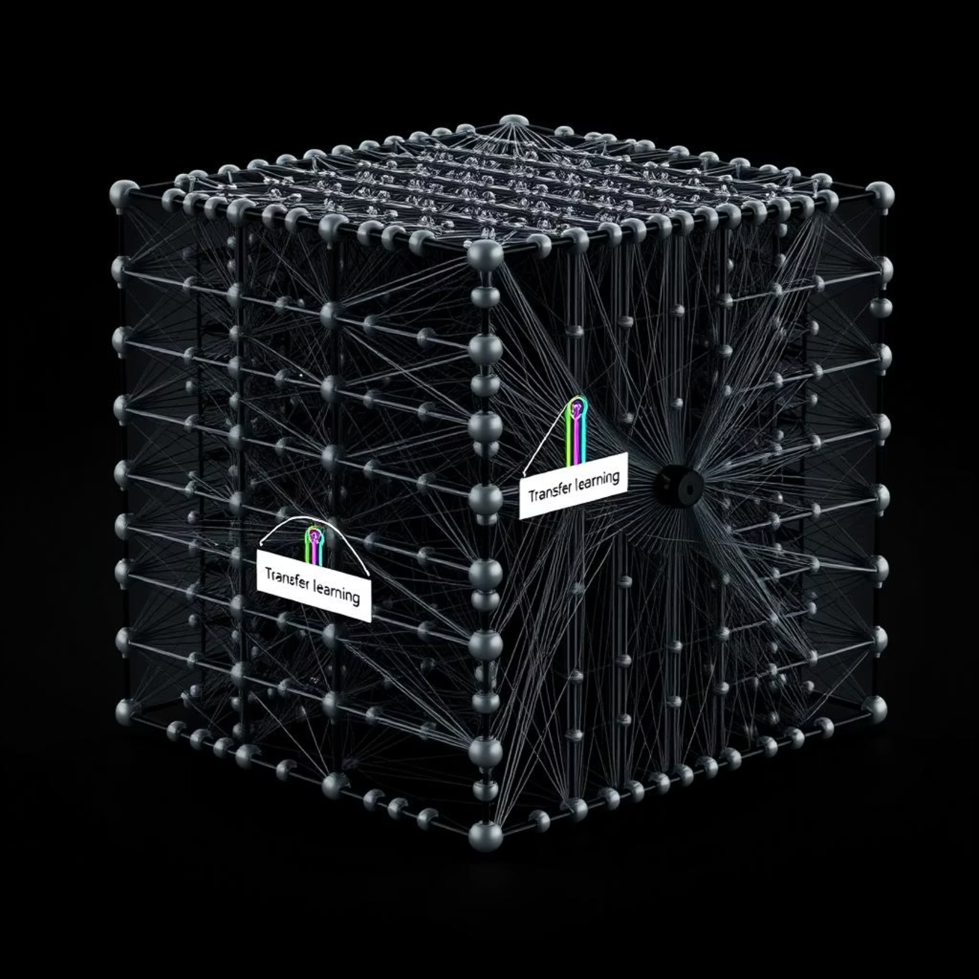
Methodology: Data & Model
From Raw Data to Intelligent Predictions
Step 1: Data Preprocessing
Ensuring uniformity and quality, all images were resized to 224 × 224 pixels. Critical data augmentation techniques, including RandomHorizontalFlip and Normalization, were applied to enhance model generalisation. A CSV-based metadata system was constructed to link file paths with their respective labels. The data was rigorously split into Train (70%), Validation (15%), and Test (15%) sets to ensure robust evaluation.
Step 2: Model Selection & Configuration
We opted for ResNet-18, a powerful deep convolutional neural network, for its proven efficacy in image classification. It was pre-trained on ImageNet and fine-tuned for our specific task. The final fully-connected layer was modified to output 3 distinct classes (Normal, Pneumonia, Tuberculosis). To address class imbalance, a Weighted Cross-Entropy loss function was employed, optimised using Adam with a learning rate of 0.0001 over 10 training epochs.

Slide 6
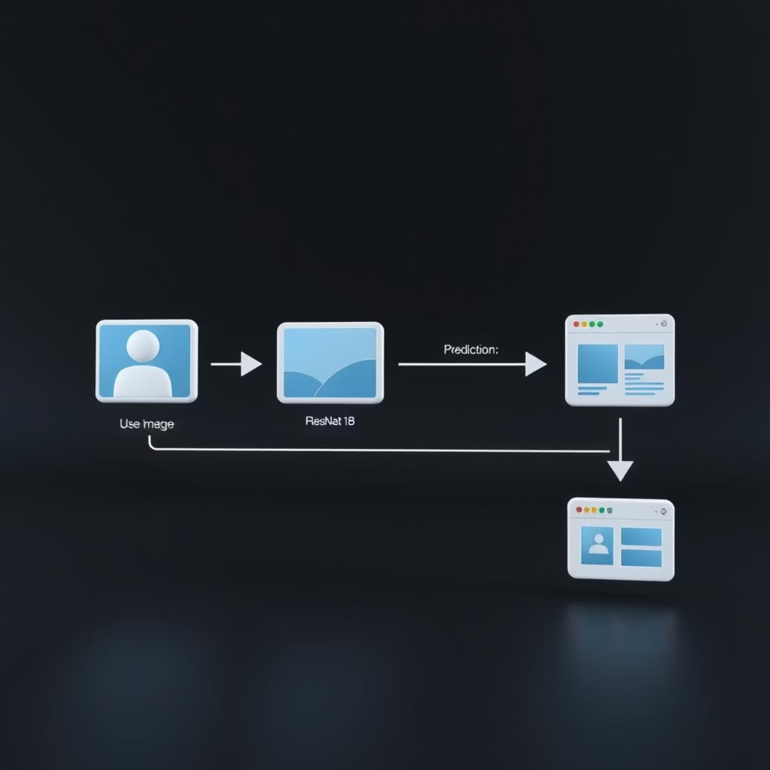
Methodology: Training & Deployment
Seamless Integration from Training to User Interface
Step 3: Model Training
The ResNet-18 model was comprehensively trained on our combined dataset. Validation accuracy was meticulously tracked after each epoch to monitor performance and prevent overfitting. The best performing model checkpoint was systematically stored as model_multiclass.pth, ensuring that the optimal version is always available for deployment and further evaluation.
Step 4: Web Application Integration
For deployment, we leveraged Flask (Python) as the core framework, providing a lightweight yet powerful backend. The frontend was developed using HTML and styled with Bootstrap 5 for a responsive and professional user interface.
User Workflow:
User uploads a chest X-ray image via the web interface.
The Flask server preprocesses the image (resize, normalise).
The preprocessed image is then fed into the trained deep learning model.
The model predicts the disease class (Normal, Pneumonia, or Tuberculosis).
The prediction, along with the uploaded image, is displayed to the user.

Slide 7
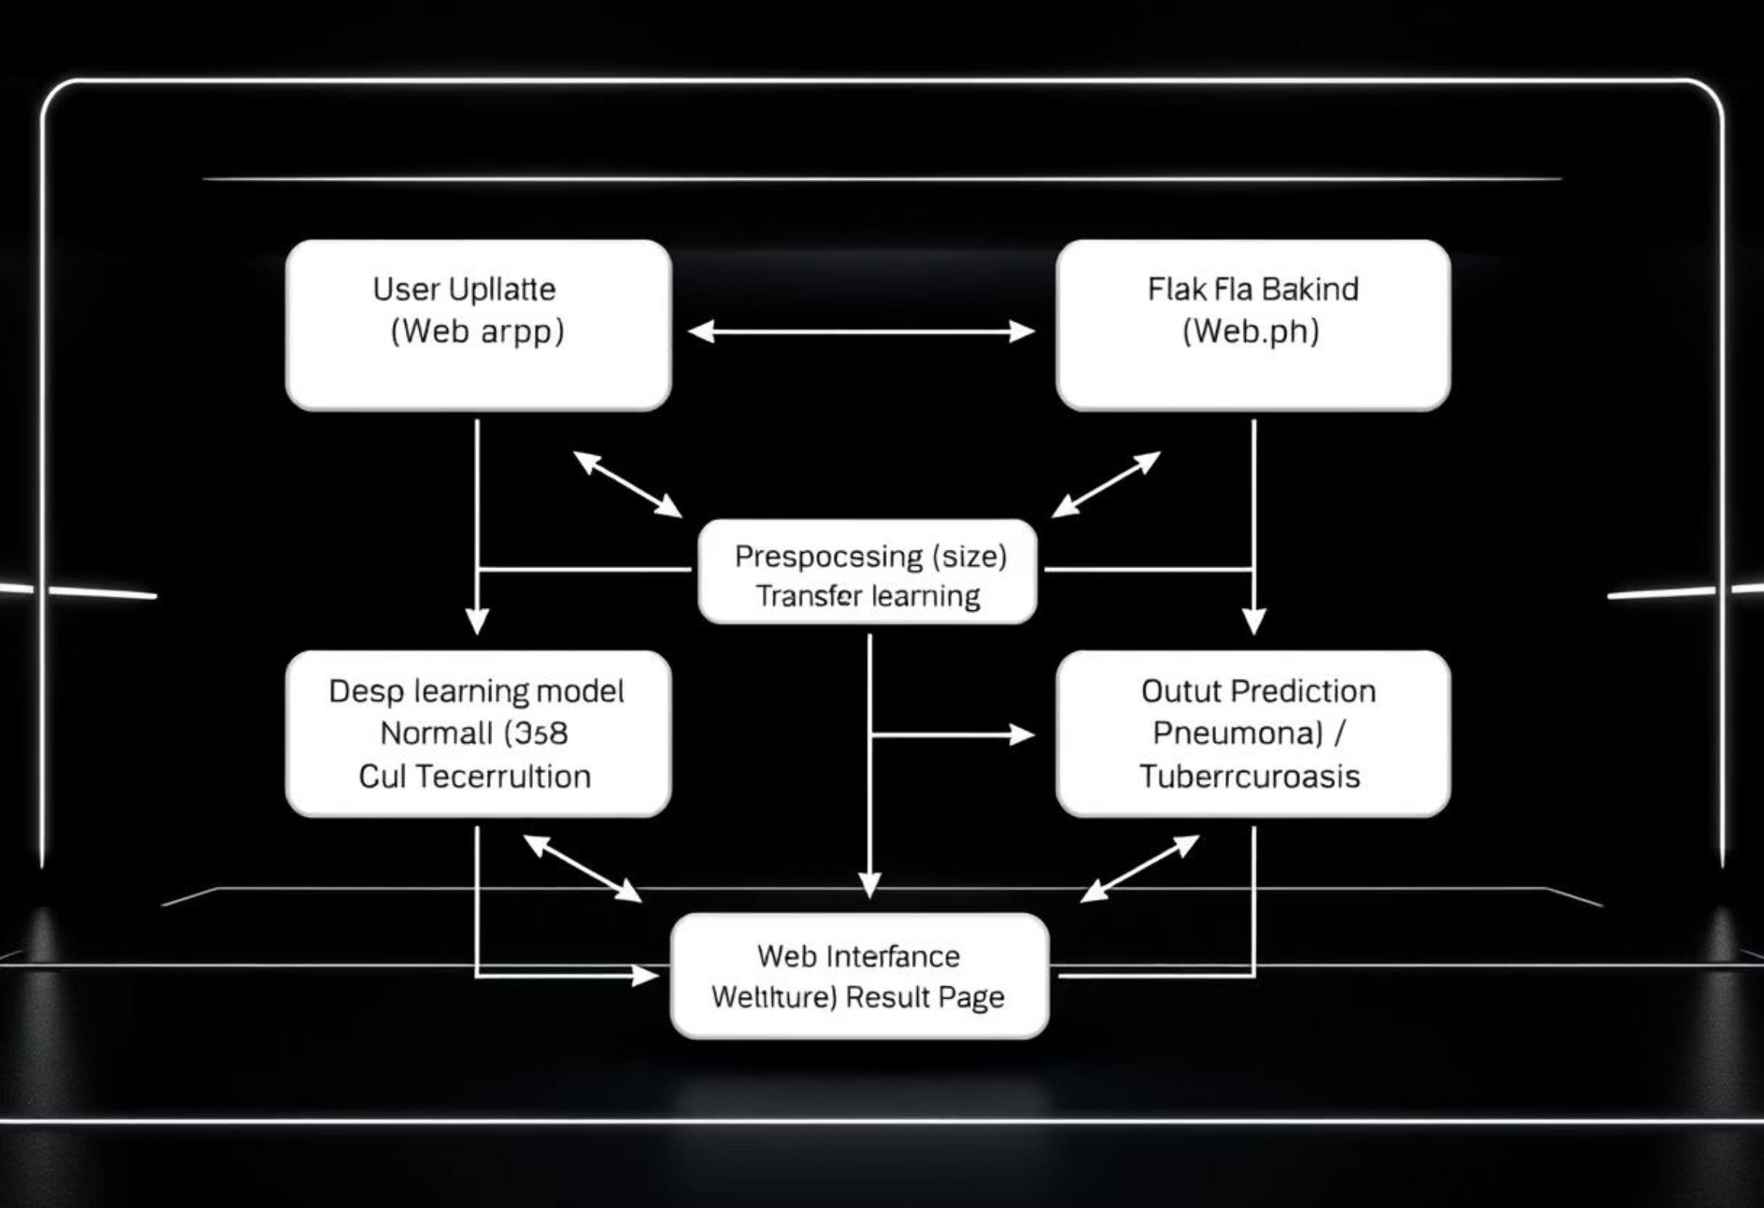
System Architecture
A Holistic View of Our Diagnostic Pipeline
This comprehensive workflow ensures a smooth and efficient diagnostic process, from image submission to result presentation, underpinning the reliability and usability of our system.
Every component is designed to work in synergy, from the user-friendly front-end to the robust deep learning backend, guaranteeing accurate and timely CXR classifications. The modular design also facilitates future enhancements and scalability.

Slide 8
Performance & Capabilities
Key Achievements and Diagnostic Insights
Results & Observations
Key Features
Our training regimen yielded consistently improving Training Accuracy across epochs, demonstrating the model's learning capability. The Validation Accuracy consistently ranged between 85–90%, indicating strong generalisation.
Multi-Class Classification
Accurate identification of Normal, Pneumonia, and Tuberculosis.
Class-wise Performance:
Normal: Achieved high accuracy, primarily due to distinctive radiographic patterns.
Transfer Learning
Pneumonia: Demonstrated good detection rates, though occasional confusion with TB patterns was noted.
Utilises the powerful ResNet-18 architecture, leveraging pre-trained knowledge.
Tuberculosis: Showed slightly lower accuracy, attributed to the comparatively smaller sample size in the training data.
Class Imbalance Handling
Weighted loss function for robust performance across varying class distributions.
Web Application Deployment
User-friendly Flask-based interface for practical clinical use.

Slide 9
Limitations & Future Outlook
Addressing Current Challenges and Envisioning Expansion
Current Limitations
Future Enhancements
Scope Limitation: Currently limited to three distinct disease categories, not encompassing the full spectrum of thoracic diseases.
Disease Expansion: Extend classification capabilities to include additional crucial diseases like COVID-19 and various forms of Lung Cancer.
Data Dependency: Performance remains intrinsically linked to the size and quality of the training datasets.
Deployment Scalability: Explore deploying the model as a comprehensive REST API or a cloud service for broader accessibility and integration.
Generalisation: May encounter challenges with previously unseen image variations, such as those from different machines, excessive noise, or low resolution scans.
Interpretability: Integrate Grad-CAM visualisations to highlight specific lung areas influencing predictions, enhancing model transparency.
Network Optimisation: Investigate the use of larger, more complex network architectures such as DenseNet or EfficientNet to further boost performance.

Slide 10
Conclusion & References
"This project successfully demonstrates the power of deep learning and transfer learning for advanced chest X-ray classification. By integrating diverse datasets and developing a user-friendly web interface, we offer a robust and scalable solution for medical image analysis."
Such AI-based systems have the profound potential to significantly assist radiologists, alleviate diagnostic workload, and facilitate earlier detection of critical respiratory diseases, ultimately improving patient outcomes.
References
Kaggle Dataset – Chest X-Ray Pneumonia
Kaggle Dataset – Tuberculosis CXR Database
Kaiming He et al., "Deep Residual Learning for Image Recognition," CVPR 2016.
PyTorch Documentation
Flask Documentation

